Slide 1
R and Linear Mixed Modelling
Bruce Peng
The University of Auckland, New Zealand.
Notes:
Talk about
- Thank Brendan for this opportunity and you guys
Self taught until next week losing bragging rights
Another disadvantage – it is possible some mentioned will be incorrect, I am still learning. Lecture slide like a serial killer’s note
LMM is probably the best mention to model repeated measure, but might be Stockholm syndrome
I design this to be a relative causal workshop, ask questions anytime you want
Hopefully by the end you guys will agree that will demonstrate that I don’t have SS but it also possible that you will be so traumatised, if that is the case we will live with our collective illusion.

Slide 2
Recap: Linear Models
Regressions
T-tests
ANOVAs
Moderation
Mediation
Linear mixed model

Slide 3
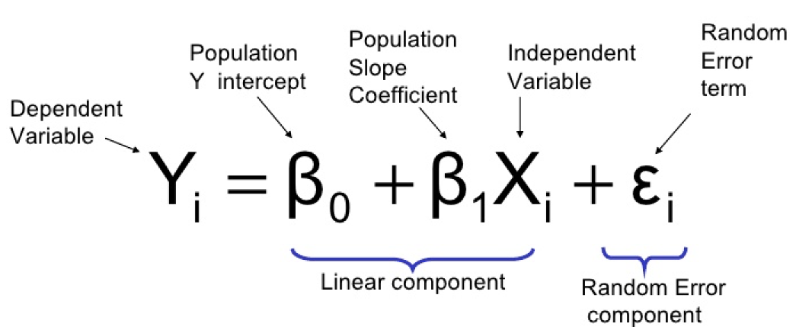
Recap: Linear Models
Regressions
T-tests
ANOVA
Moderation
Mediations
Linear mixed model

Slide 4
Recap: Linear Models
Assumptions of linear models
Linearity
Normality of residuals.
Homogeneity of variance
Independence
Homogeneity of regression slopes
Require balanced datasets
Notes:
MLM does not require homogeneity of variance within each condition, nor compound symmetry and sphericity
Because LMM inferences does not rest of these assumptions.

Slide 5
Recap: Linear Models
Assumptions of linear models
Linearity
Normality of residuals.
Homogeneity of variance*
Independence
Homogeneity of regression slopes
Require balanced datasets.
Notes:
MLM does not require homogeneity of variance within each condition, nor compound symmetry and sphericity
Because LMM inferences does not rest of these assumptions.

Slide 6
Benefits of Linear Mixed Model
Say ‘bye bye’ to the assumptions of independence.
Cast aside the assumption of homogeneity of regression slopes.
Laugh in the face of missing data.
ML estimates parameters with available data.
Continuous? No problem!
Very flexible (Kind of a double edge sword).
Note Andy Field is much wittier than I.
Notes:
Flexibility
No agreement in ~80% issues
Need researcher’s knowledge of design and what they want to achieve
More chance of p-hacking, double dipping
Advice- consistency and transparency.

Slide 7

Level of Inference is Important
2 sources of variances in repeated measures
Within participants
Between participants
Models
LMM_1 | 1.51
LM_1 | 1.49
LM_2 | 1.80
Notes:
It turns out that the LMEM does not estimate each of the 100 ’s u0’s and each of the 100 u1 ’s. Instead, it estimates their variances.

Slide 8
Level of Inference is Important
What is wrong with the means!?
Notes:
Start with a discussion of correlation in repeated measures
Ecological fallacy

Slide 9
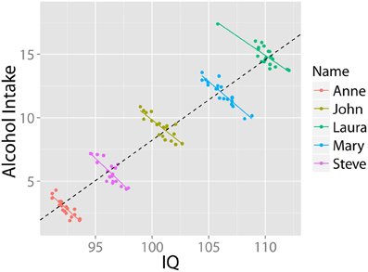
Level of Inference is Important
Simpsons Paradox
Notes:
One option to solve this is by using raw scores but then we are not separating the different types of variance apart- can separate this in linear mixed model for DV but need centring for IV to solve this for IV.

Slide 10
Level of Inference is Important
Vividness measure | Mean correlation |  | Within-subject correlation
 | Imagine helping | Estimate helping | Imagine helping | Estimate helping
Detail | 0.35* | 0.46** | 0.39*** | 0.21***
Coherence | 0.55*** | 0.37* | 0.45*** | 0.28***

Slide 11
Independence Violations: Clustering
Independence = Each data point is independent from the next.
Violated in repeated measures?
Yes, there are tests that account for these (e.g. repeated-measures ANOVA and paired sample t-test).
But what if you have 2 or more non-independent structures in your design?
Linear mixed model.

Slide 12
Imagine Helping Paradigm
An electrical fire broke out in this person’s house, no people were hurt but the house suffered serious damage.

Slide 13
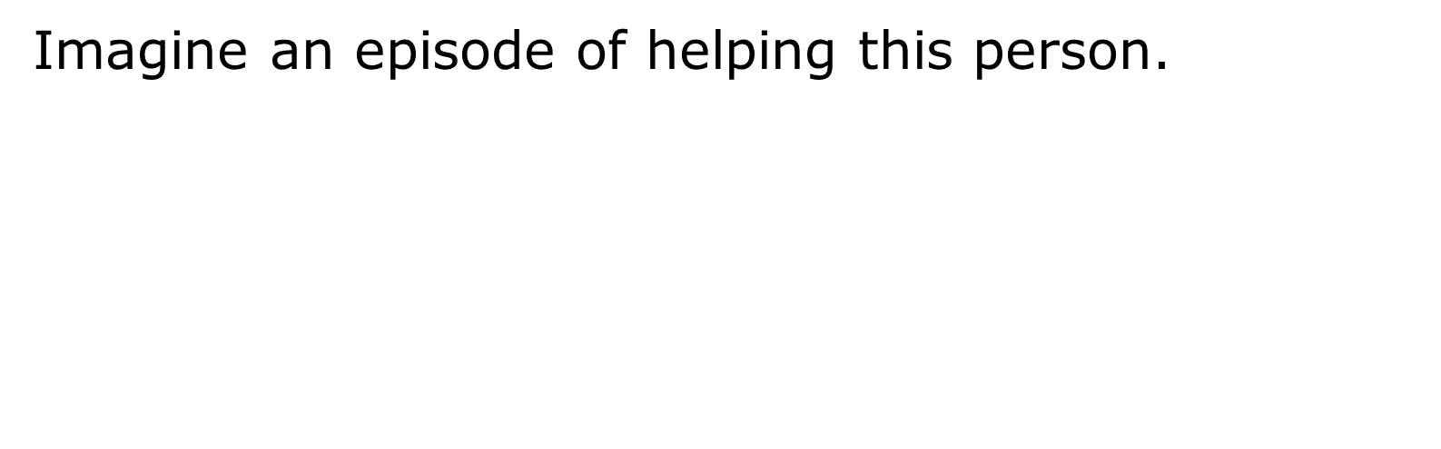
Imagine Helping Paradigm

Slide 14
Clustering in context: Crossed
Level 2
John
Sarah
Jared
Stephanie
……..x30
Story 1
Trial 1
Trial 2
.
.
.
.
.
.
Trial 29
Trial 30
Trial 1
Trial 2
.
.
.
.
.
.
Trial 29
Trial 30
Trial 1
Trial 2
.
.
.
.
.
.
Trial 29
Trial 30
Trial 1
Trial 2
.
.
.
.
.
.
Trial 29
Trial 30
Story 2
Level 1
.
.
.
.
.
.
Story 29
Story 30
Notes:
If do not account for stimuli then it cannot be generalize to all stimuli.

Slide 15
Clustering in context: Nested
Level 3
Chinese
American
……..x15
Level 2
John
Sarah
Jared
Stephanie
……..x30
Trial 1
Trial 2
.
.
.
.
.
Trial 29
Trial 30
Trial 1
Trial 2
.
.
.
.
.
Trial 29
Trial 30
Trial 1
Trial 2
.
.
.
.
.
Trial 29
Trial 30
Trial 1
Trial 2
.
.
.
.
.
Trial 29
Trial 30
Level 1

Slide 16
Clustering in context: Crossed and Nested
Level 3
Chinese
American
……..x15
Level 2
John
Sarah
Jared
Stephanie
……..x30
Story 1
Trial 1
Trial 2
.
.
.
.
.
.
Trial 29
Trial 30
Trial 1
Trial 2
.
.
.
.
.
.
Trial 29
Trial 30
Trial 1
Trial 2
.
.
.
.
.
.
Trial 29
Trial 30
Trial 1
Trial 2
.
.
.
.
.
.
Trial 29
Trial 30
Story 2
.
.
.
.
.
.
Story 29
Story 30

Slide 17
Random & Fixed Effects
Random effects
Stimuli
Participants
Cultures
Fixed effects
Gender
SES
Conditions
How do we decide?
Random classification- the sample is a random selection of a population.
Fixed classification – the population of interest only falls in one or a few categories (e.g. gender and experimental manipulations).

Slide 18

When should we include clustering?
Intra-Class correlation (ICC)
Or just use linear mixed models if we have any kind of clustering

Slide 19
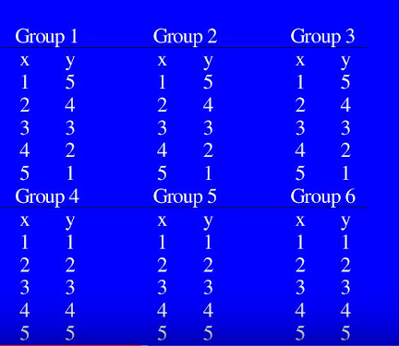
When should we include clustering?

Slide 20
When should we include clustering?
Group 1 | Group 2 | Group 3 | Group 4 | Group 5 | Group 6
Y mean | 3 | 3 | 3 | 3 | 3
Y sigma | 1.5 | 1.5 | 1.5 | 1.5 | 1.5
ICC = 0

Slide 21
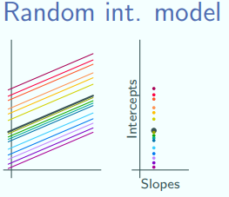
Random Effects
Willingness to help
Control (0)
Experimental (1)
Conditions

Slide 22
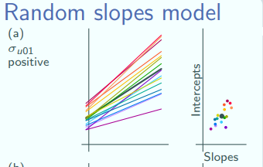
Random Effects
Willingness to help
Control (0)
Experimental (1)
Conditions

Slide 23
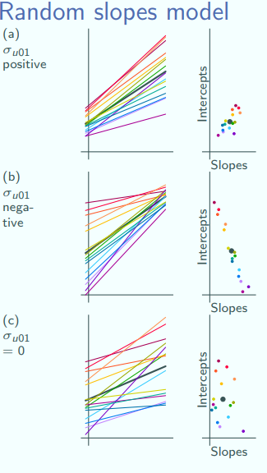
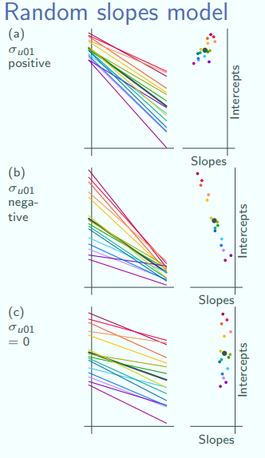

Slide 24
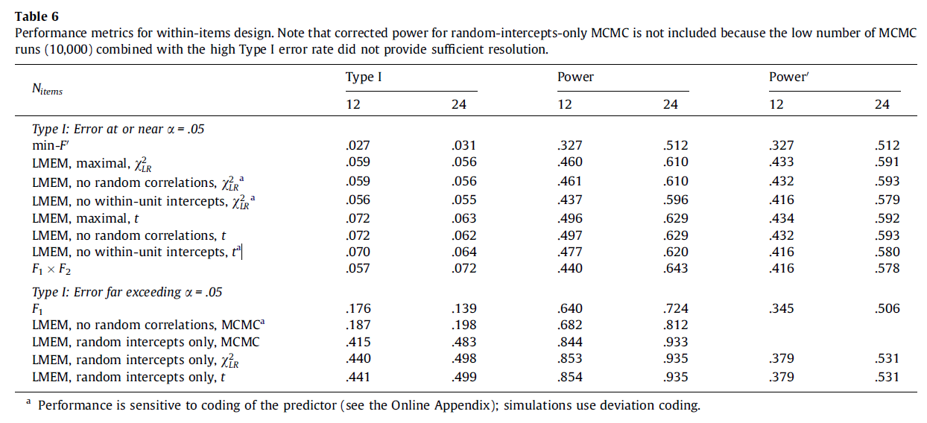
Random Slopes are important
Notes:
Inclusion of random slope is one of the rare cases where there is no disagreement in LMM literature , everyone agrees random slopes and needed but similar to evolution how we should do it differ.

Slide 25
How do I decide which random slopes to include?
Forward inclusion
Keep it maximal
Too many parameters (2x2 design will have 10 parameters + the fixed effect parameters: totalling 16 )
Backward exclusion
Identify a parsimonious model
Best path vs predetermined inclusion criteria
Notes:
Parismonious have relatively large increase in power while maintaining type 1 for smaller sample size (30P, 10I) whereas larger sample size still show some increase in power(50, 20)

Slide 26
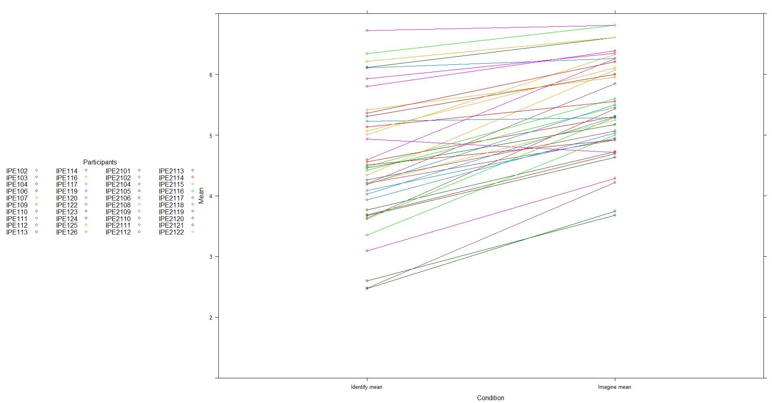
Random Slopes

Slide 27
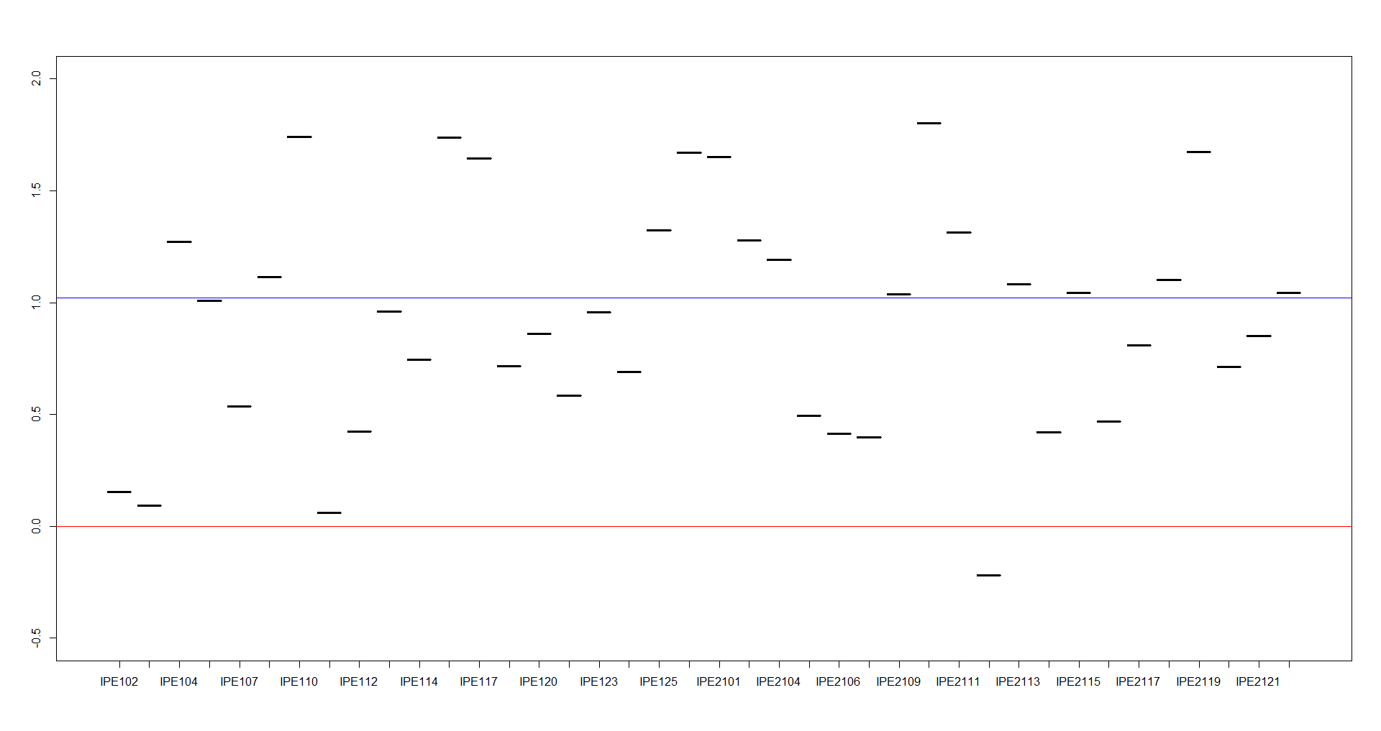
Random Slopes

Slide 28
Centring
Continuous IV also have 2 sources of variance.
Group mean centring (Centring within Cluster)
Each data point within each cluster is centred to the cluster’s mean
Grand mean centring.
Each data point is centred to the overall mean across all cluster.
What kind of centring you should use depend on the research question.
See Ender and Tofighi (2007) for more details
Notes:
Under group mean centring we can account for:
Individual differences in the IV.
Individual differences in interpretation of IV.

Slide 29
Centring
Which level of inference are repeated-measures designs typically interested in?
Within cluster centring is often more appropriate in these designs.

Slide 30
Useful resources
Basics
Peugh, J. L. (2010). A practical guide to multilevel modeling. Journal of School Psychology, 48(1), 85–112. https://doi.org/10.1016/j.jsp.2009.09.002
Brauer, M., & Curtin, J. J. (2017). Psychological Methods Linear Mixed-Effects Models and the Analysis of Nonindependent Data : A Unified Framework to Analyze Categorical and Continuous Independent Variables that Vary Within-Subjects and/or Within-Items. Psychological methods, 0(999), 1–23.
Repeated measures
Quené, H., & Van Den Bergh, H. (2004). On multi-level modeling of data from repeated measures designs: A tutorial. Speech Communication, 43(1–2), 103–121. https://doi.org/10.1016/j.specom.2004.02.004
Centring
Enders, C. K., & Tofighi, D. (2007). Centering Predictor Variables in Cross-Sectional Multilevel Models: A New Look at an Old Issue. Psychological Methods, 12(2), 121–138. https://doi.org/10.1037/1082-989X.12.2.121
Model Selection.
Bates, D., Kliegl, R., Vasishth, S., & Baayen, H. (2015). Parsimonious Mixed Models. Retrieved from http://arxiv.org/abs/1506.04967
Barr, D. J., Levy, R., Scheepers, C., & Tily, H. J. (2013). Random effects structure for confirmatory hypothesis testing: Keep it maximal. Journal of Memory and Language, 68(3), 255–278. https://doi.org/10.1016/j.jml.2012.11.001
Matuschek et al., 2017. (2017). Balancing Type 1 error and power in LMM. 1–11. https://doi.org/.1037//0033-2909.I26.1.78

Slide 31
Working in R
Make sure you have R-studio installed.
We are going to work through some basics in R, using the data set from the replication study of the imagine helping paradigm.

